Slide 1

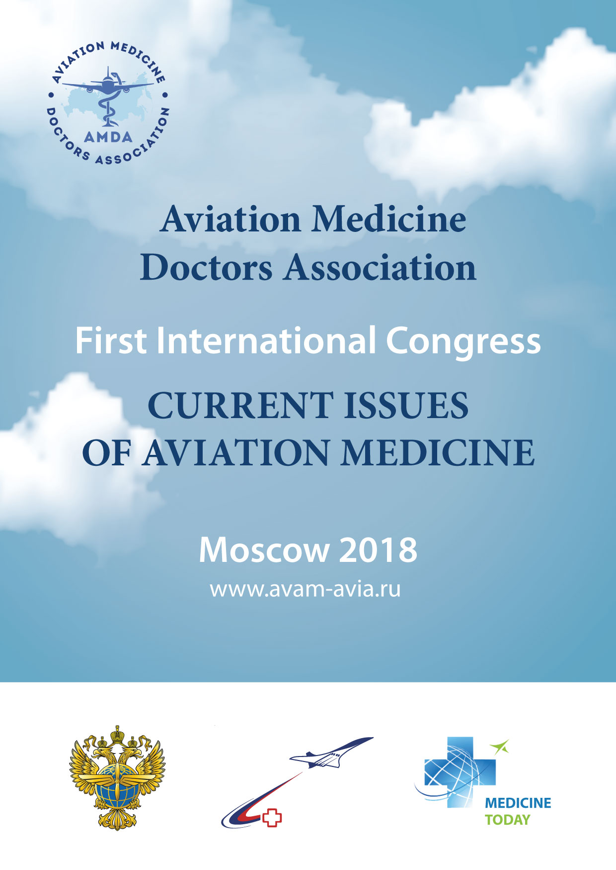
www.

Slide 2


ESAM participation and EC meeting at AMDA Congress in Moscow
17-19 October, 2018
Dr. Verba O. – Vice President of AMDA

Slide 3
Aviation Medicine Doctors Association
Aviation Medicine Doctors Association (AМDA) was established to provide comprehensive assistance within aviation community in developing aviation medicine and exchanging research results and experience both throughout the Russian Federation and globally.
The activities of the Association (AМDA) encompass interaction with governmental bodies and Federal Air Transport Agency “Rosaviatsiya” as well as The Ministry of Healthcare of the Russian Federation and Occupational safety centers on health issues of flight operational safety.

Slide 4
The aims of AMDA are to be an acknowledged leader in Aviation Industry as well as to dedicate world trends in Civil Aviation to the most sophisticated goals.
Aligning current regulations and approaches with commonly accepted market realities.
Aviation Medicine
Doctors Association

Slide 5
AMDA Congress
In 2018 АMDA is hosting the First Congress of Aviation Medicine with participation of European Society of Aerospace Medicine (ESAM)
The purpose of the Congress is enhancing medical provision, developing preventive aviation medicine, fatigue risks management, supporting programs of health promotion of aviation personnel, providing their reliability and fitness that is crucially important in terms of flight safety

Slide 6
Moscow,
October 17-19,
2018
We warmly invite you to The First Congress AMDA «Current issues of Aviation Medicine»
Title: The First Congress AMDA «Current issues of Aviation Medicine»
When: 17-19 October, 2018
City: Moscow
Organizer: Aviation Medicine Doctors Association
Supported by: European Society of Aerospace Medicine ESAM
Technical organizer: LLC «Medicine Today»

Slide 7
Moscow,
October 17-19,
2018
The Target Audience:
Medical aviation examiners of Flight expert medical commissions and aerospace medical practitioners, physicians, cardiologists, ophthalmologists, psychologists, neurologists, surgeons, endocrinologists, tuberculosis coordinators, oncologists, urologists, psychiatrists as well as functional diagnosis and lab specialists.
We are expecting about 200 participants
Exhibition
In frames of the Congress there will be Exhibition of manufacturers and distributors of pharmaceutical drugs, treatment and diagnostic equipment, nutrition and biological active supplements, protective and emergency kits as well as software packages and devices for Aviation Medicine.

Slide 8

The Draft Program
«Current issues of aviation medicine»
1. Medical flight expert assessment in civil aviation at its current stage.
1.1. Policies and regulations in the Russian Federation, accomplishment of the tasks assigned by the President of The Russian Federation on 29/04/2016
№ 800.
1.2. Monitoring and analysis of health fitness of civil aviation personnel.
1.3. Clinical aspects of medical flight assessment: examination protocols and medical evaluation criteria on civil aviation aircrew members with chronic illnesses.
1.4. Treatment and rehabilitation of civil aviation personnel affected by different kinds of illnesses. Medical clearance for aviation duties after treatment and rehabilitation
1.5. The order of establishment and designation of Flight Expert Medical Commissions of Civil Aviation
1.6. Existing Training programmers on required competence in aviation medicine and medical flight expertise provided for Chairmen of Flight Expert Medical Commissions and designated medical examiners.
1.7 Data evaluation and risk management in Flight Safety System.

Slide 9
The Draft Program
2. Medical dynamic supervision and follow-up monitoring of civil aviation personnel within the period between examinations performed by responsible aviation medicine practitioners of airlines.
2.1. Fostering healthy lifestyle and delivering preventive procedures to civil aviation personnel.

Slide 10
3. Medical provision of flight operational safety.
3.1. In-flight medical emergencies. Strategies and procedures of medical assistance for passengers.
3.1.1. Medical clearance to meet applicable requirements for passengers.
3.2. Aircrafts first aid medical equipment and supplies.
3.3. Reasons for grounding at pre-flight medical check-ups.
The Draft Program

Slide 11
The Draft Program
4. Collaboration between Aviation Medicine Doctors Association (AMDA) and European Society of Aerospace Medicine (ESAM).
4.1. Report from ESAM President on activities of the European Society of Aerospace Medicine.
4.2. Main scientific goals of ESAM (Advisory Board Committee report).
4.3. Joint meeting of ESAM (EC) Executive Committee and АВАМ Presidium.

Slide 12
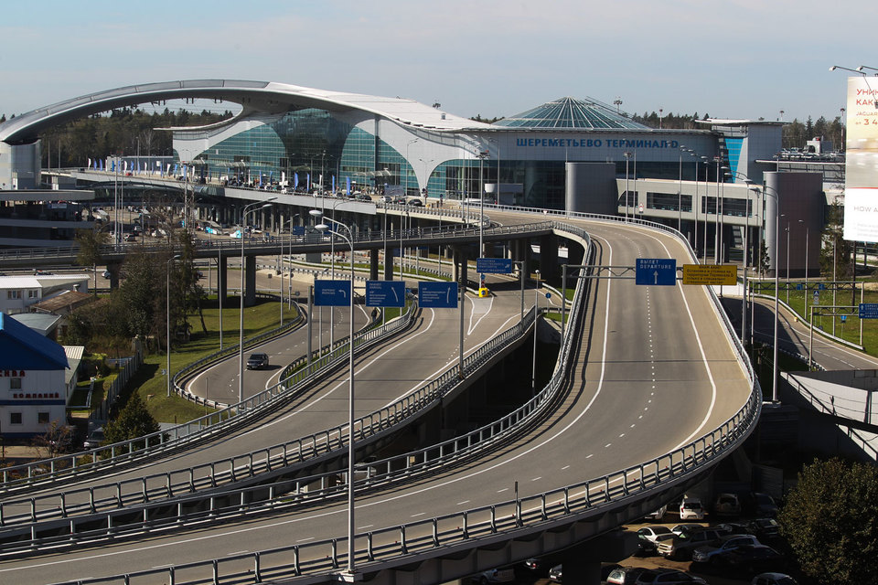
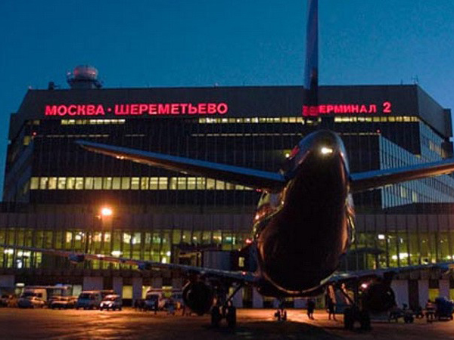
Location
Sheremetyevo Airport is the largest international airport in Russia

Slide 13

Location
Sheremetyevo International Airport is the largest Russian airport handling scheduled international flights. The Airport’s network of routes includes more than 300 destinations. The Sheremetyevo Airport’s services are utilized by the representatives of three major aviation alliances: SkyTeam (Air France, KLM, Delta, CSA Czech Airlines, Alitalia, China Southern Airlines, Korean Air, etc.); Star Alliance (SAS, Air China, LOT, Adria Airways, etc.); Oneworld (Finnair).
Sheremetyevo is the first Russian airport which became the best by the independent rating ASQ and got international recognition of passengers and experts.
According to ACI ASQ rating, Sheremetyevo Airport second time was recognized as the best airport in Europe in service quality.

Slide 14
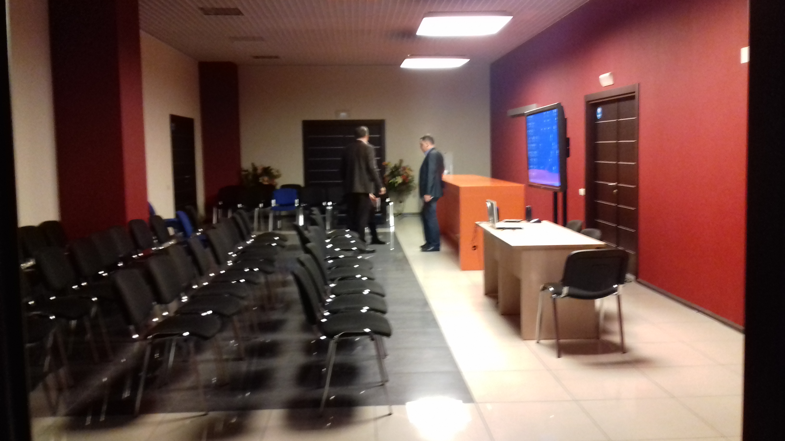
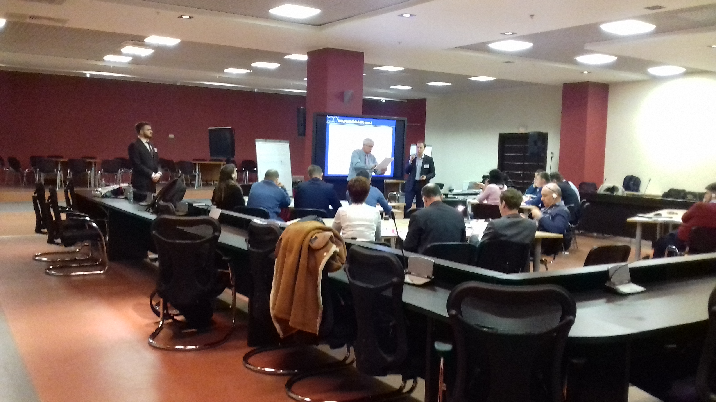
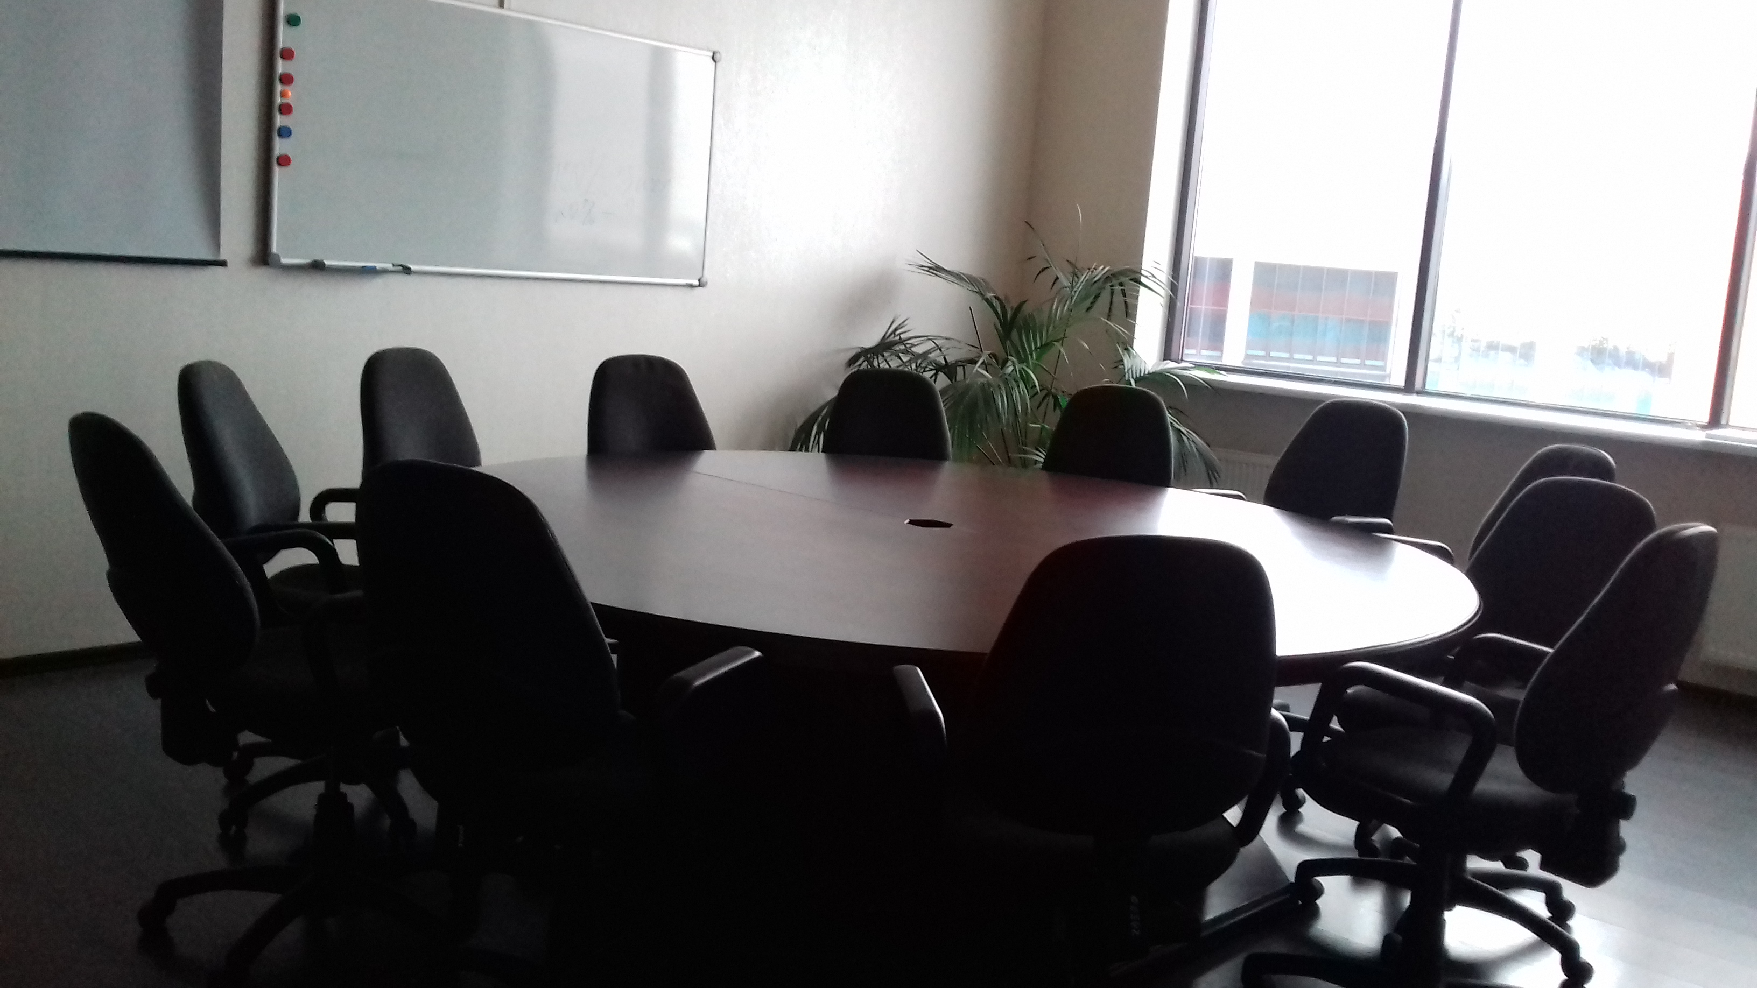
Location
The Congress will be held in the territory of the Corporate University of Sheremetyevo.

Slide 15
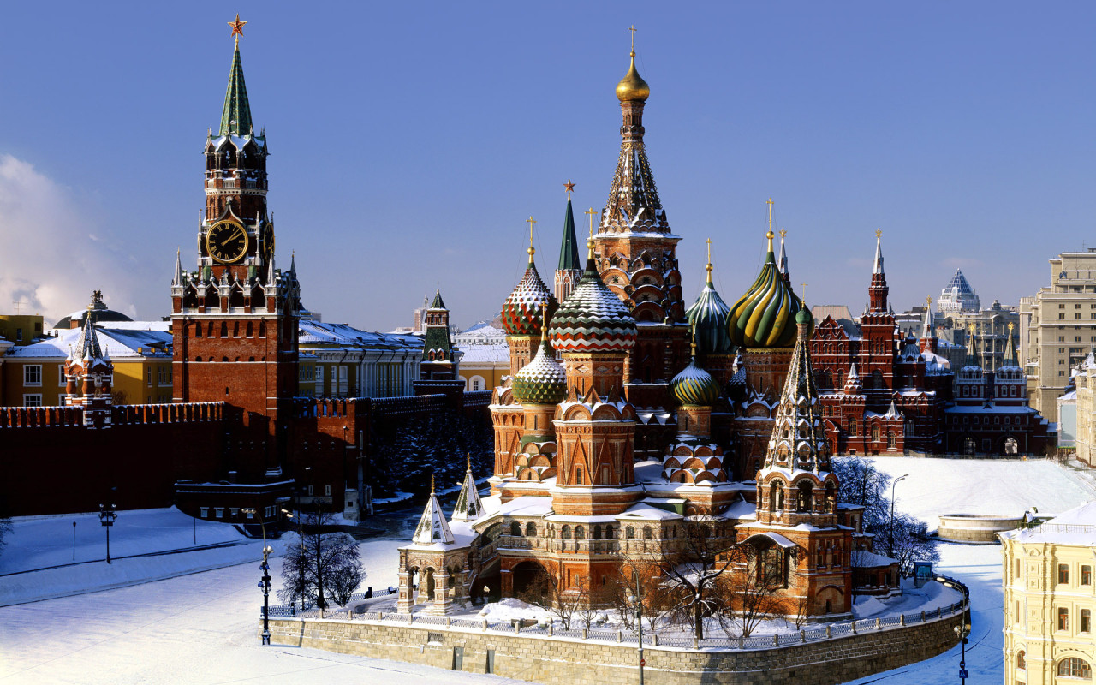
Location
The Congress site is located in a convenient transportation position.
Aeroexpress, from Sheremetyevo: every 30 min; 6 euros,
35 min to the city center (Belorusskaya station)
By metro line, you can get to the Kremlin (just 2 stations)
The metro fare is O.8 euro.

Slide 16
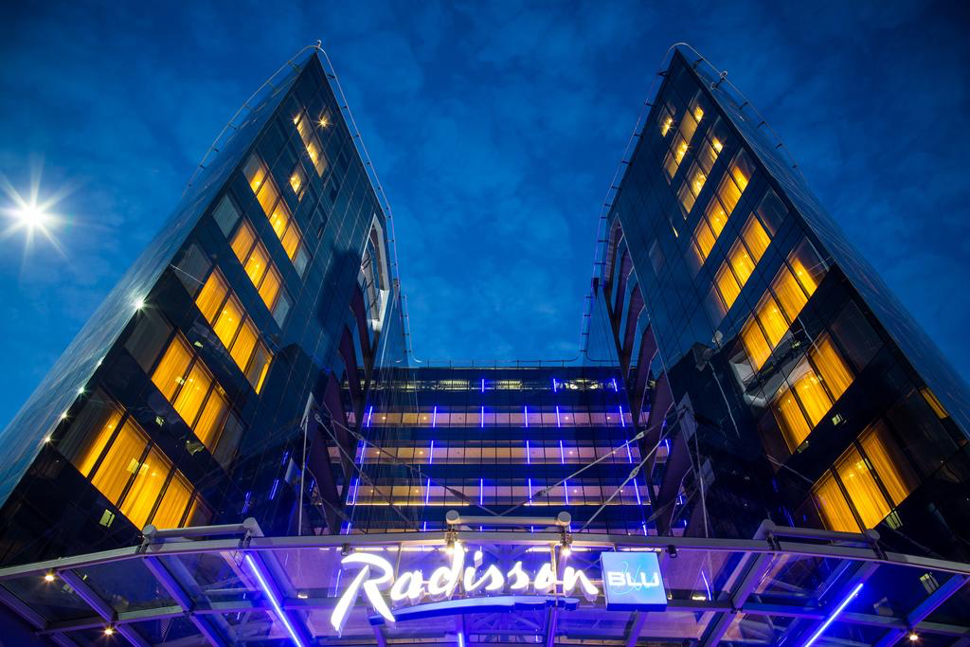
Accommodation
Radisson Blu
60 eur. per night for single standard room /
64 eur. for a double standard room (including breakfast and VAT).
From the Radisson hotel you can directly get to the Congress site (terminal E)

Slide 17
Accommodation
Hotel Park INN
43 eur. per night for single standard room /
50 eur. for a double standard room (including breakfast and VAT)

Slide 18
Thank you for your attention!
125367, Moscow, Russia
7 Ivankovskoe shosse,
Tel.: +7 495 490 0391
www.avam-avia.ru

